Slide 1
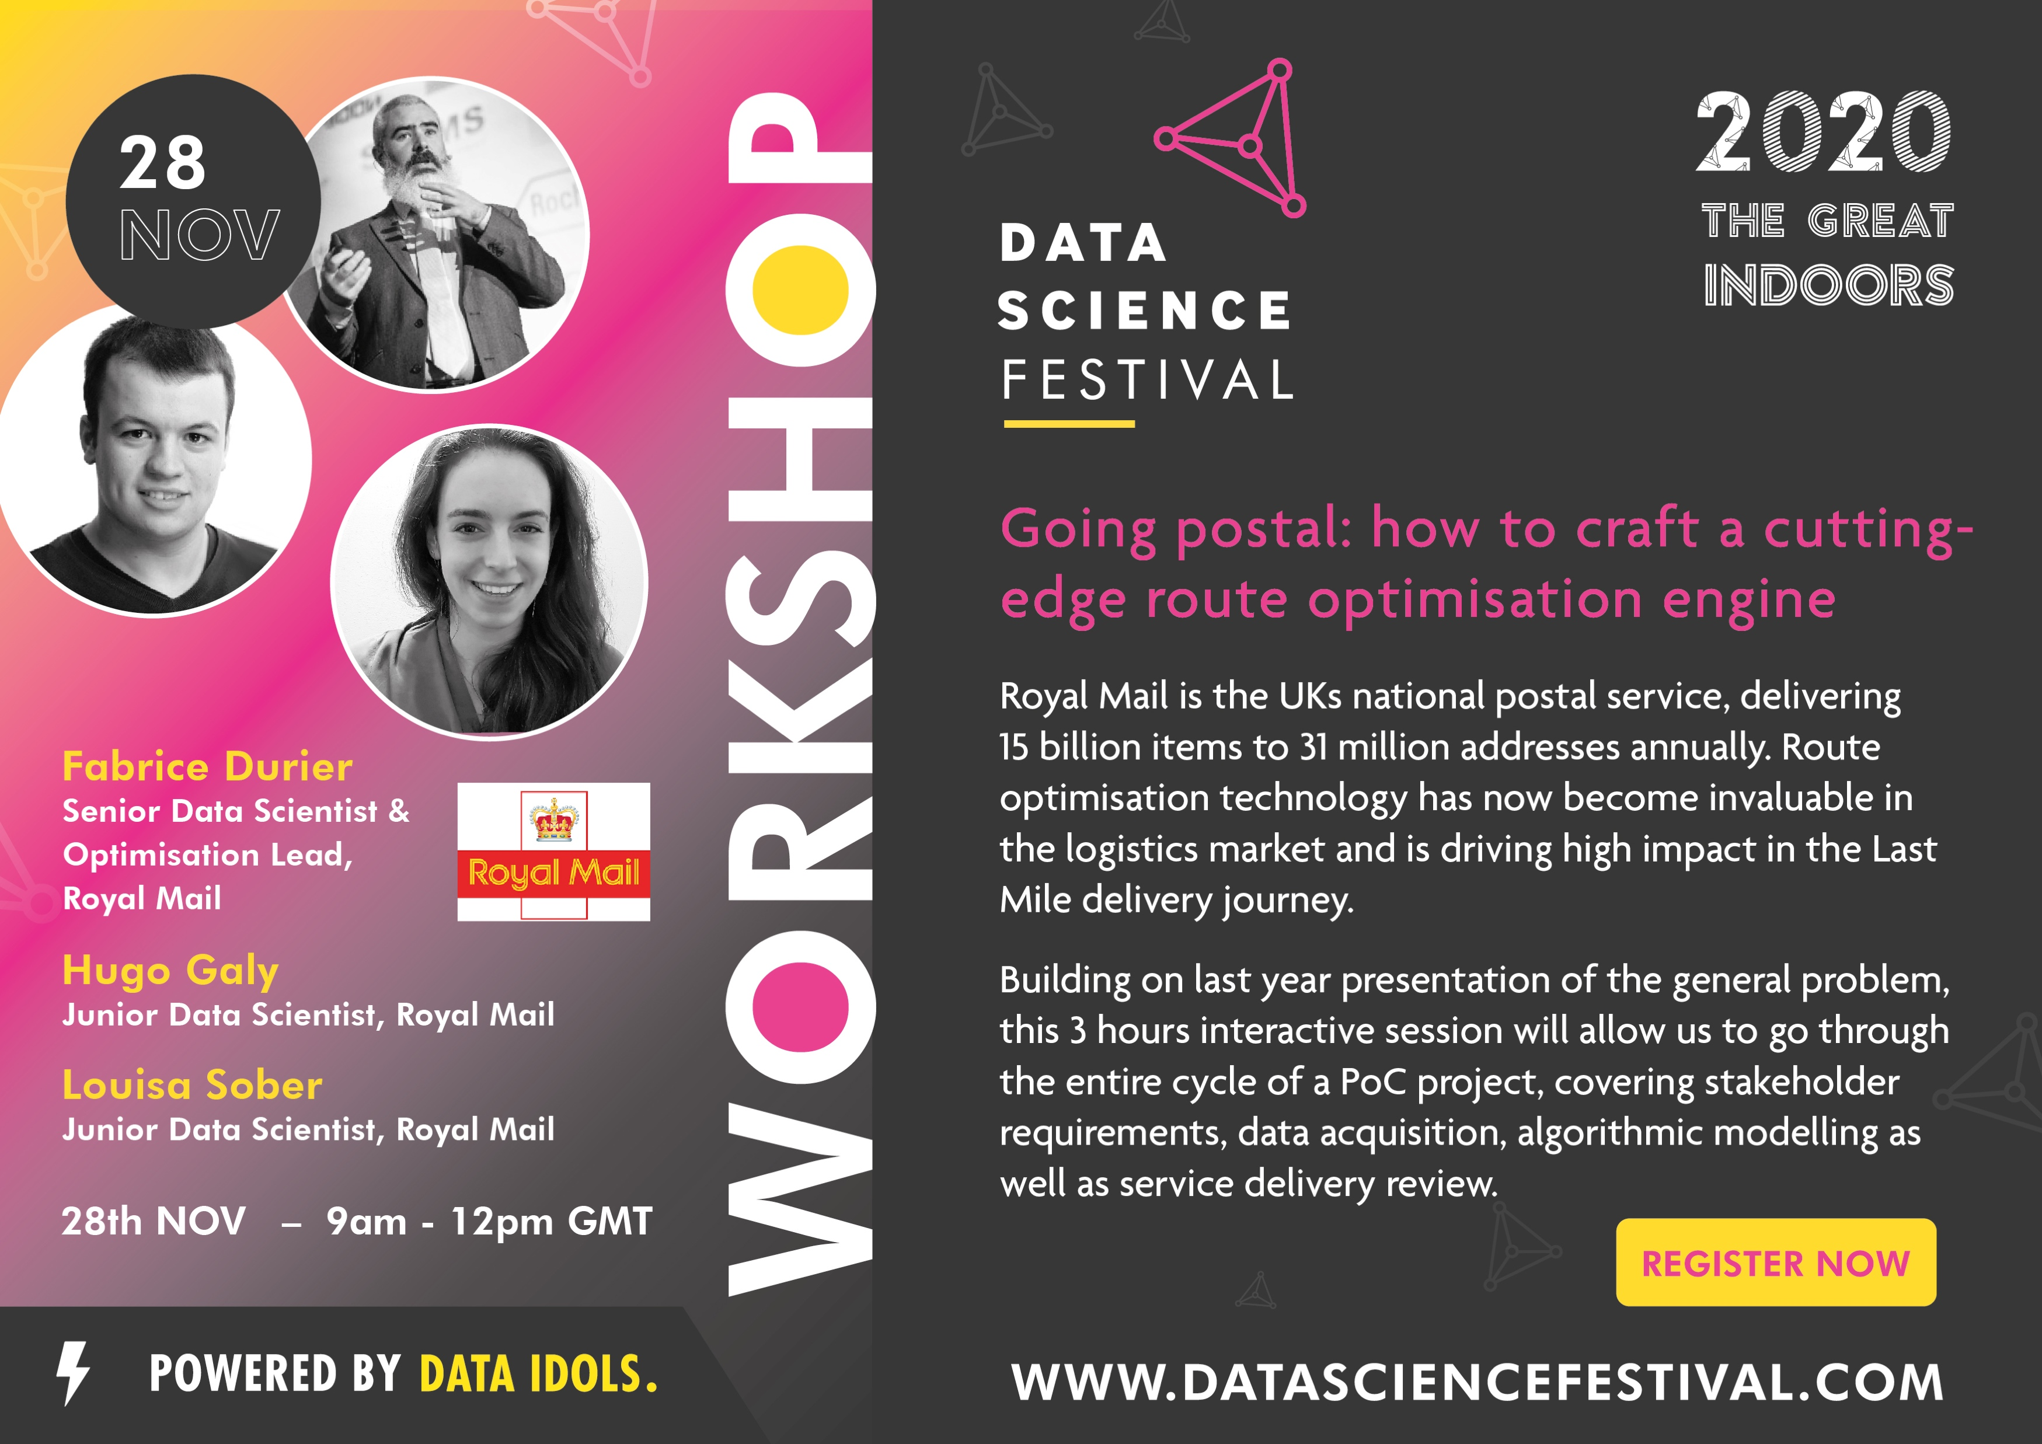

Slide 2

Going postal: how to craft a cutting-edge route optimisation engine in-house that suits your business needs
Data Science @ Royal Mail
The People
The Projects
Business Case
Challenges and Benefits
An Example
Science & Technology
A known Problem
An Agile approach
Hands-on…

Slide 3


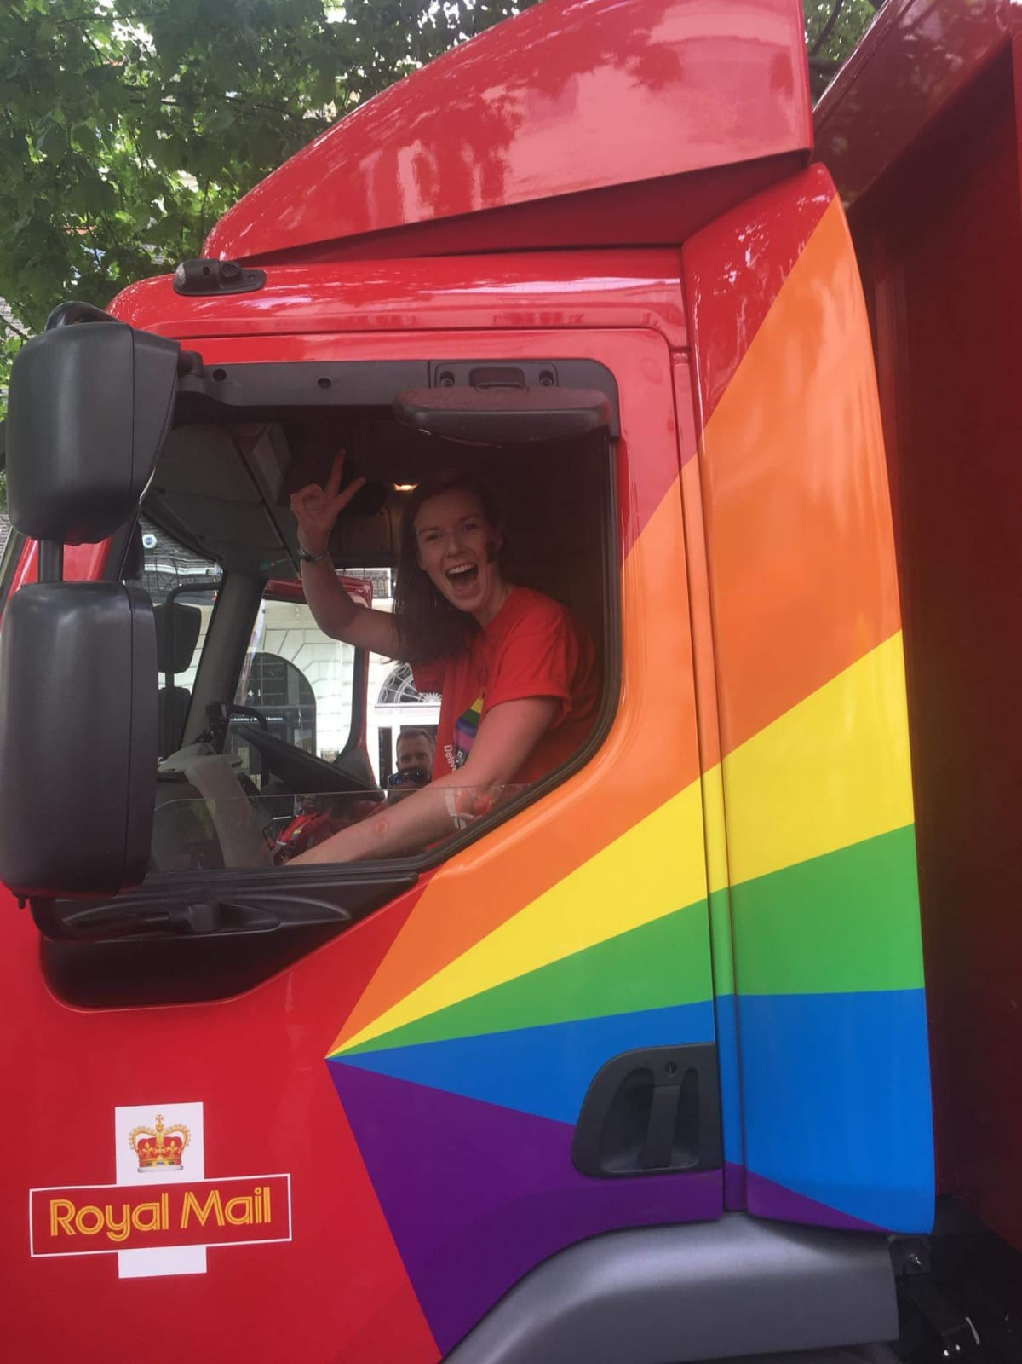
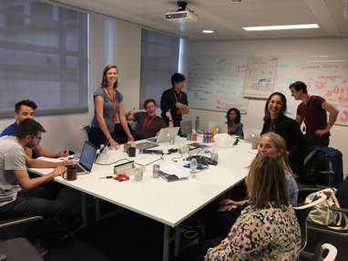

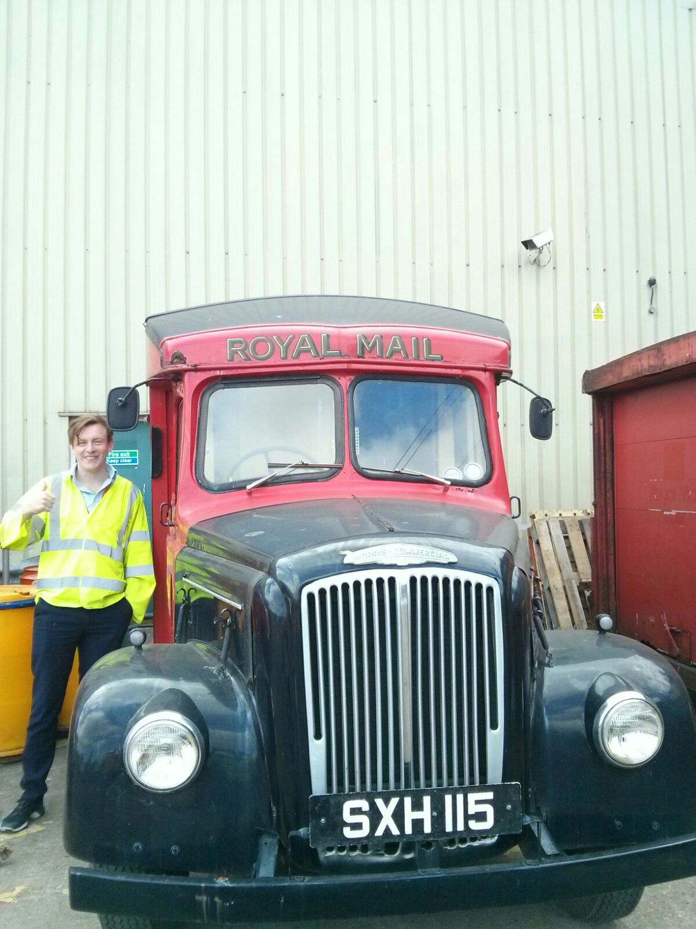
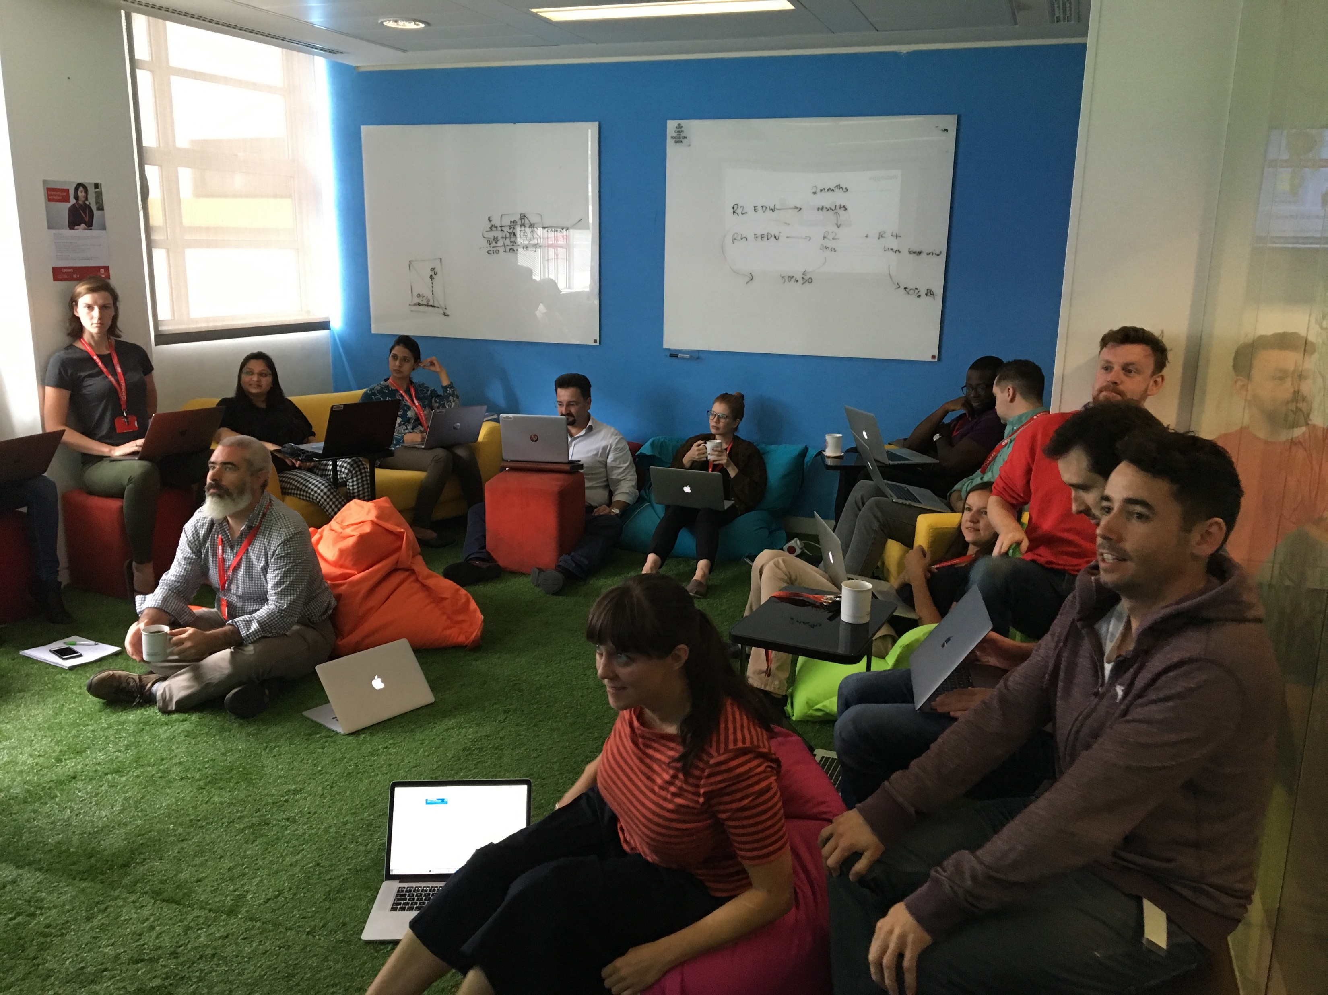
I. Data Science Team
Diversity is Key
13 countries
7 16
PhD | 12 | 52%
MSc | 6 | 26%
BSc | 3 | 13%
App. | 2 | 8%
Many backgrounds
3
Notes:
should we mention a bit more about RM culture? in general? like the london network, connect stuff, diversity groups…
Remember to talk about Agile, Analysts, Viz & Engineers!!

Slide 4
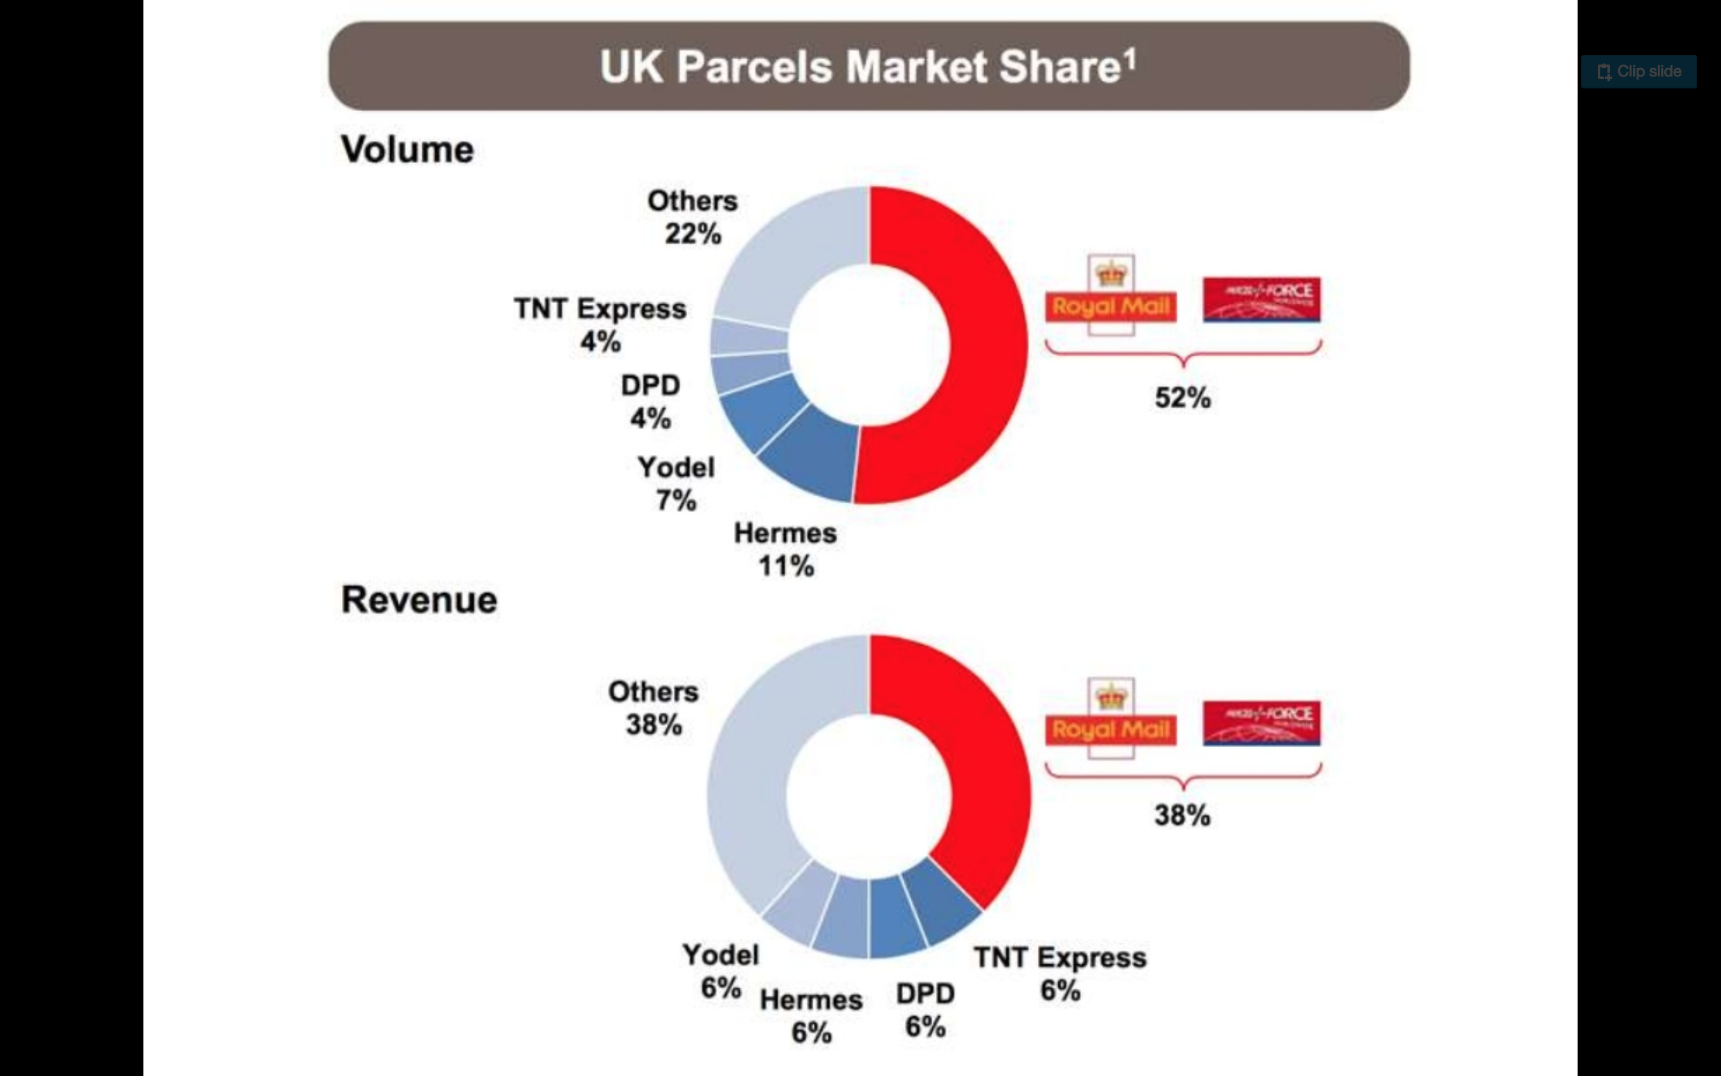
II. Business Case
Parcel Delivery Market
Traffic of 1.9 billion items, up by 9%
Royal Mail handled 52% of Market Share in 2017-18
Delivering to over 29 million addresses, 6 days a week
Growing expectations for service quality in a highly competitive market…
Notes:
Parcel delivery, the Present & Future (Growth and Challenges): give business numbers and list challenges

Slide 5
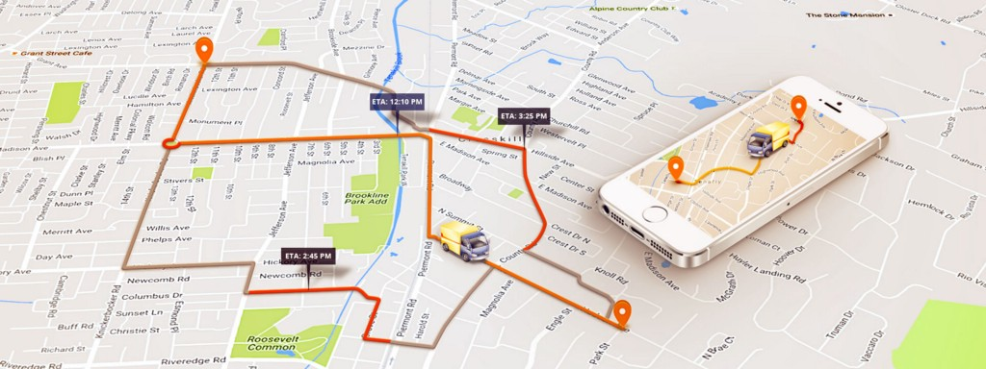
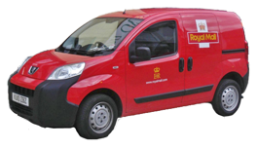
II. Business Goal
Motivation
“ Utilise our resources efficiently given the daily variation of demand.”
Requirements
Deliver high quality service
Rely on Network of Delivery Offices
Account for Fleet Constraints
Account for Workforce Constraints
Need of a tool that can manage the sorting and ordering of parcels
Notes:
Pivoting from the past efficiently (Enhancing Customer satisfaction): remind how it’s done now and why it needs evolving (list benefits)
Account for local variation of demand
Provide shorter time window predictions
Provide detailed parcel-sorting and delivery-ordering manifests
Provide savings on both time for delivery and fuel costs

Slide 6
III. Optimisation Problem
Mock Example
Setup
Delivery: 50 parcels
Max. Vans: 5
Time Window: 4h
Goal
Visit every DP only once
Minimise time & distance

Slide 7
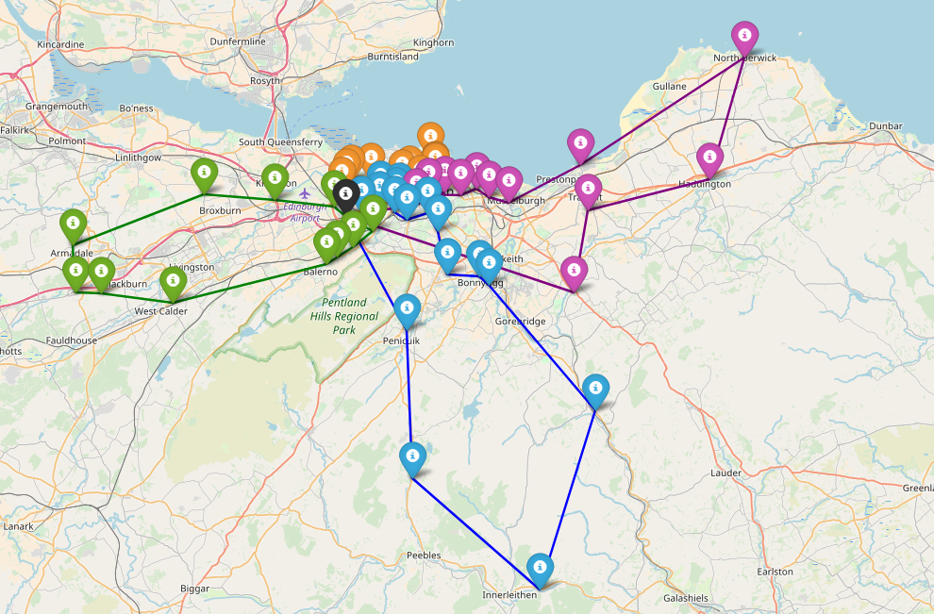
III. Optimisation Problem
Mock Example
Solution
4 Vans only
Total Time: 756 min
Total Distance: 383 km

Slide 8
III. Vehicle Routing Problems
A long History of Academic Research
1959
2008
1960 – 1980: Looking for Exact Algorithms
1990 – 2010: Development of Meta-Heuristics
2010 – 2015: Introduction of Bio-inspired Algorithms
2016+: First attempts at Reinforcement Learning
NP-hard Combinatorial Problem
Generalisation of the Traveling Salesman Problem
Many approaches to reach Near-Optimum solutions
Modern variants accounting for diversity of constraints
2017
1999
1962
2005
2010
2017
1980
2011
2007
2018
8
Notes:
Pivoting from the past efficiently (Enhancing Customer satisfaction): remind how it’s done now and why it needs evolving (list benefits)

Slide 9
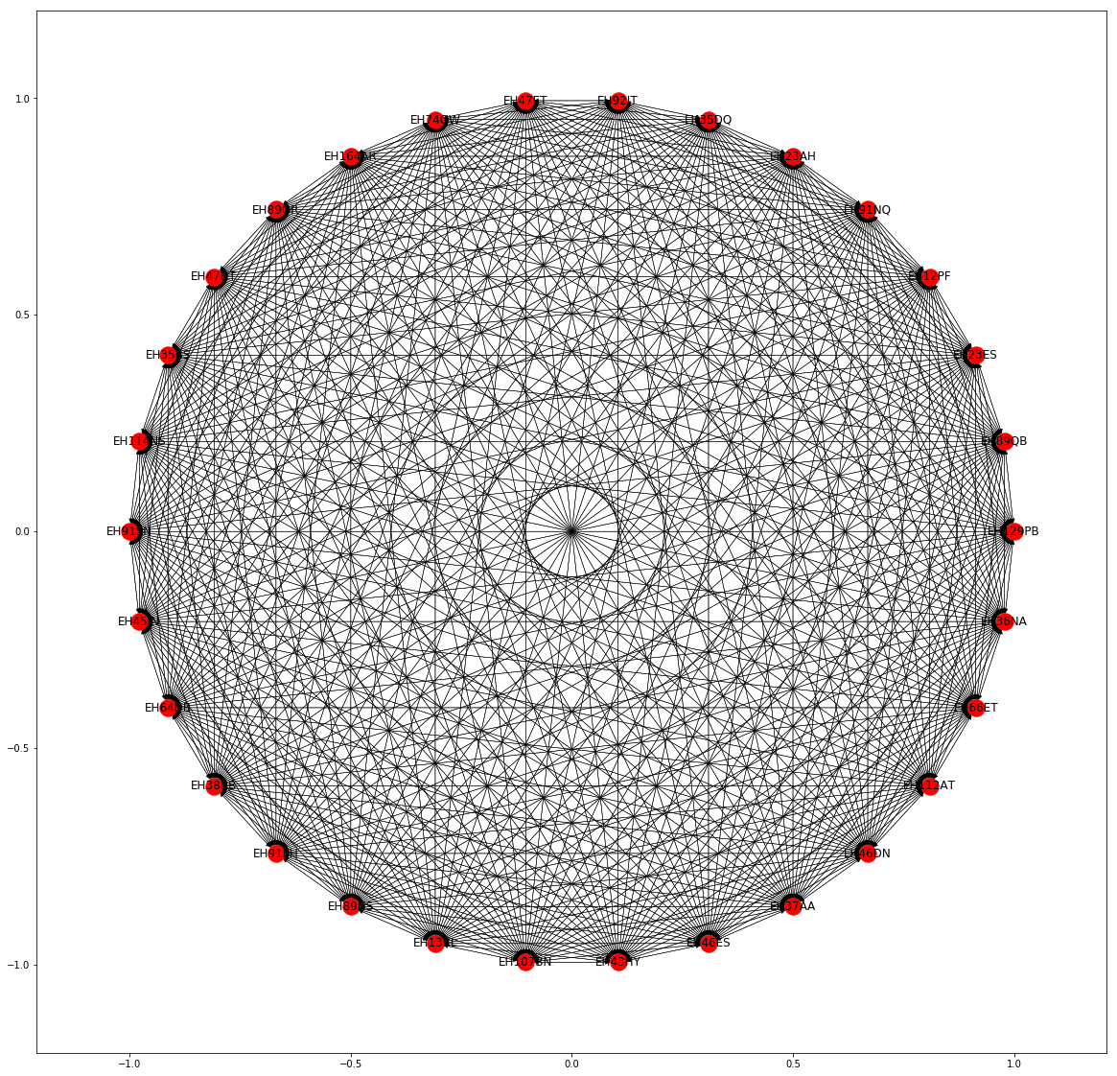
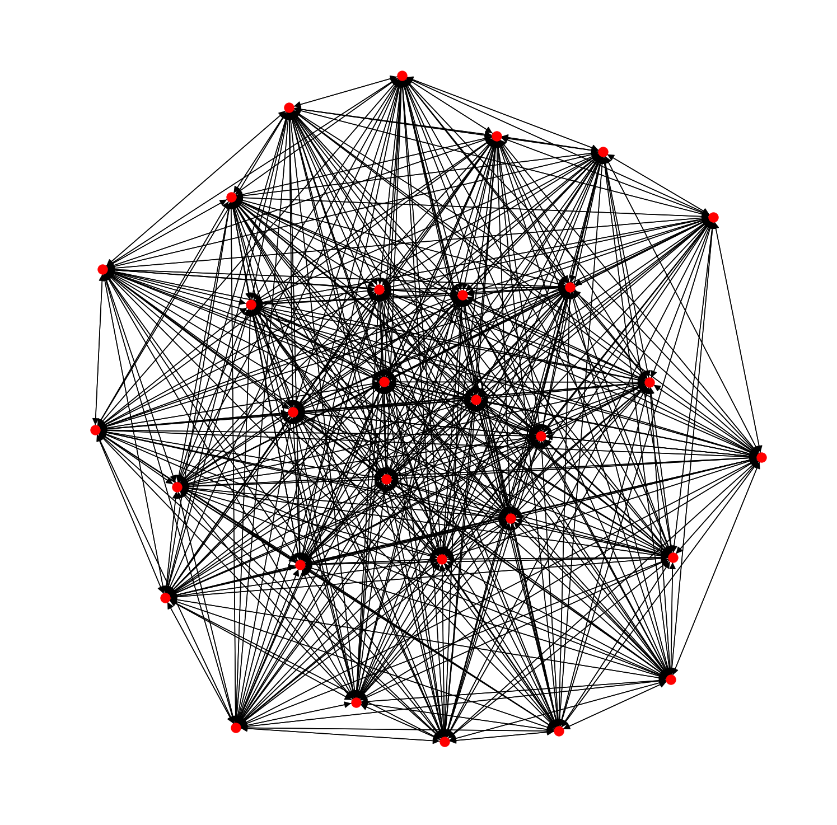
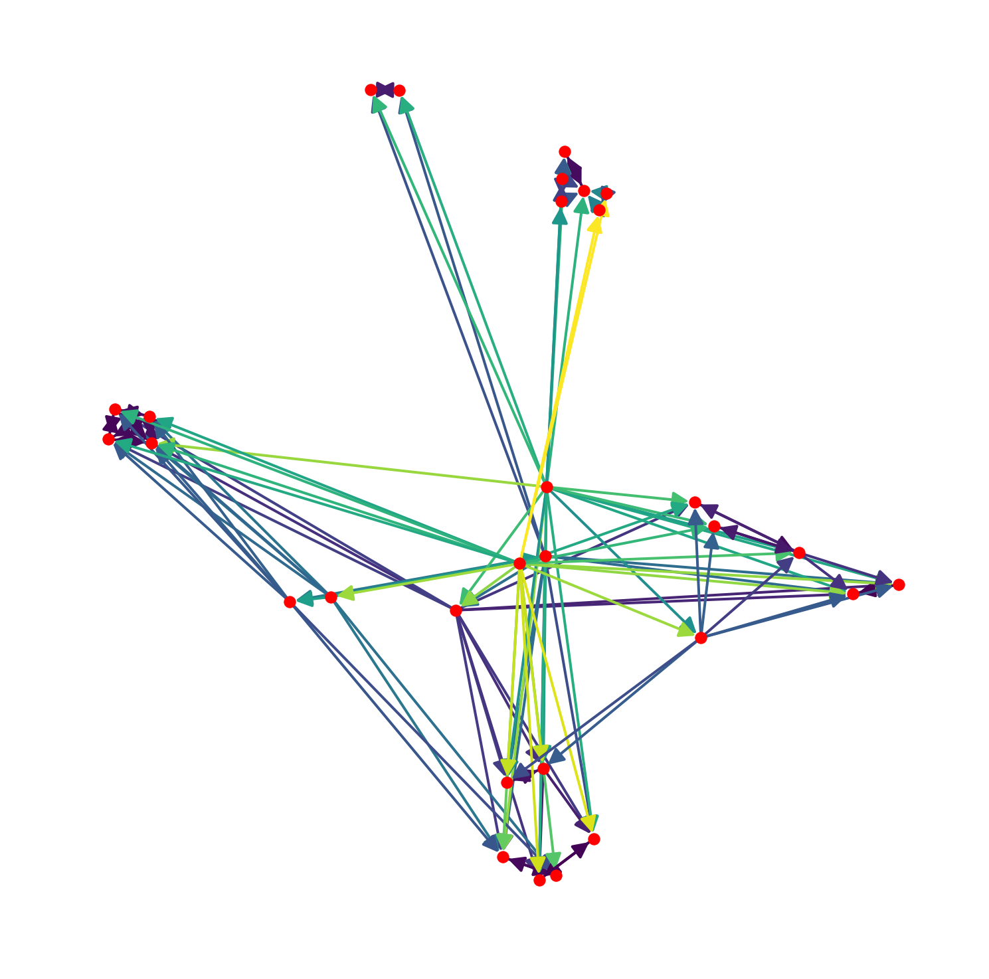
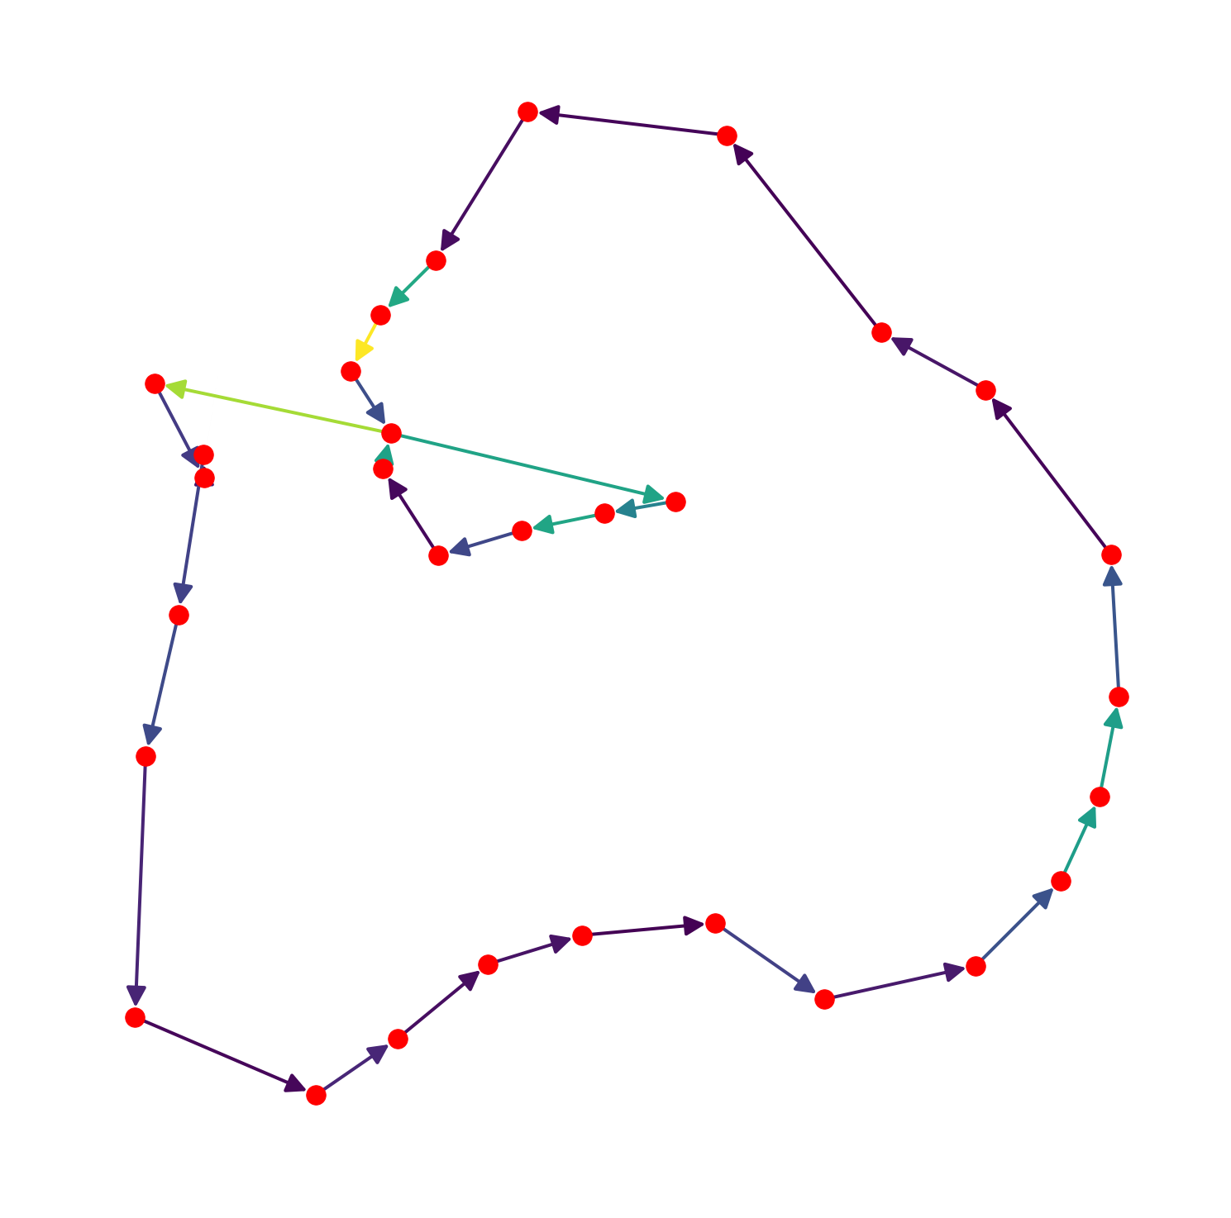
III. Scientific Illustration
From Graph to Routes
Fully Connected
Partially Connected
Disconnected Tours
Heuristics: Operators on Nodes & Edges
Oriented Search through Solution space
(Graphs taken from solving a real problem)

Slide 10

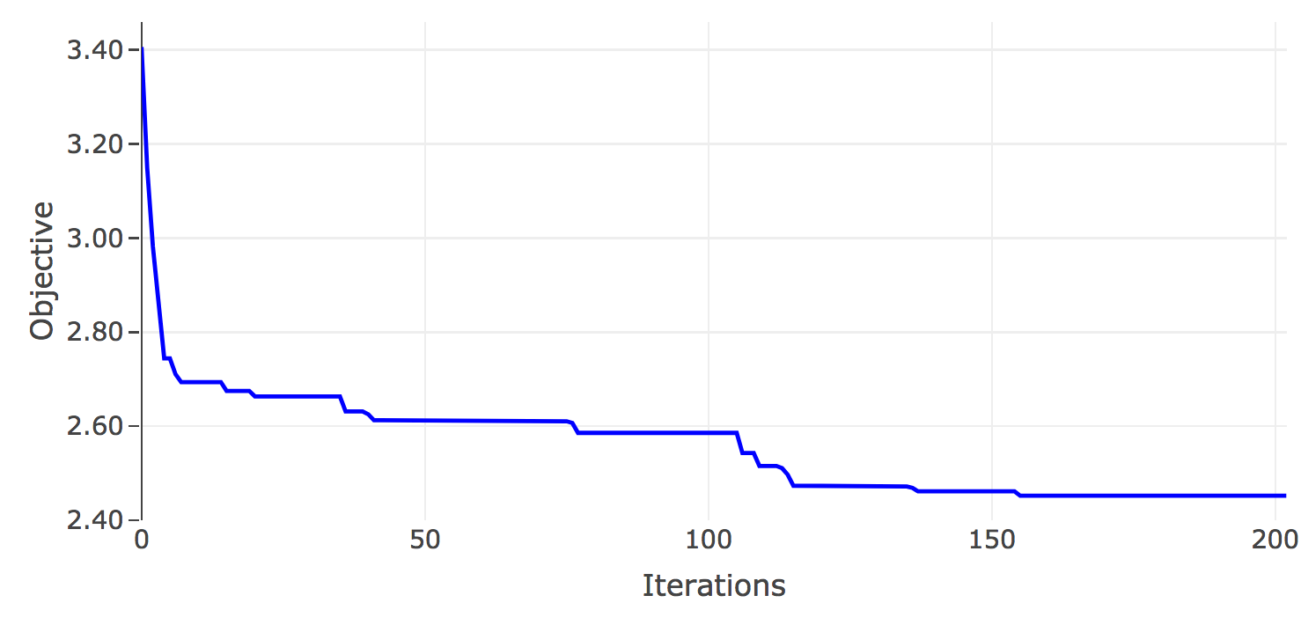
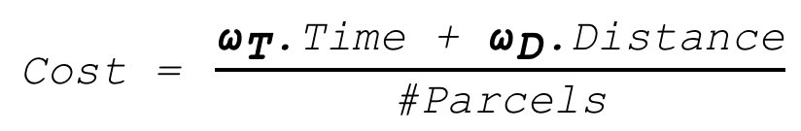
III. Optimisation Objective
Iterative Procedure
$$\text{Cost}\text{ = }\frac{{\text{ω}}_{\text{T}}\text{.}\text{Time}\text{ + }{\text{ω}}_{\text{D}}\text{.}\text{Distance}}{\text{\#}\text{Parcels}}$$
Business Parameters
Hourly Rate: ω_{T}
Kilometric Rate: ω_{D}

Slide 11

III. Software Architecture
Data Acquisition
Initialisation
Initial solution
Global Search (LNS)
Destroy
Repeat until Convergence
Repair
Local Search (k-opt)
Simulated Annealing
Produce Recommendation
User Interface

Slide 12



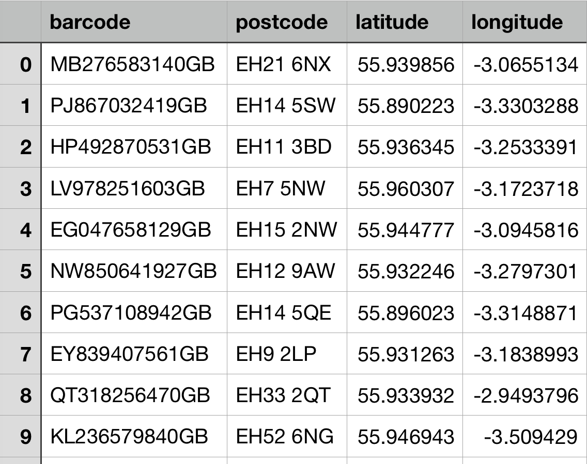
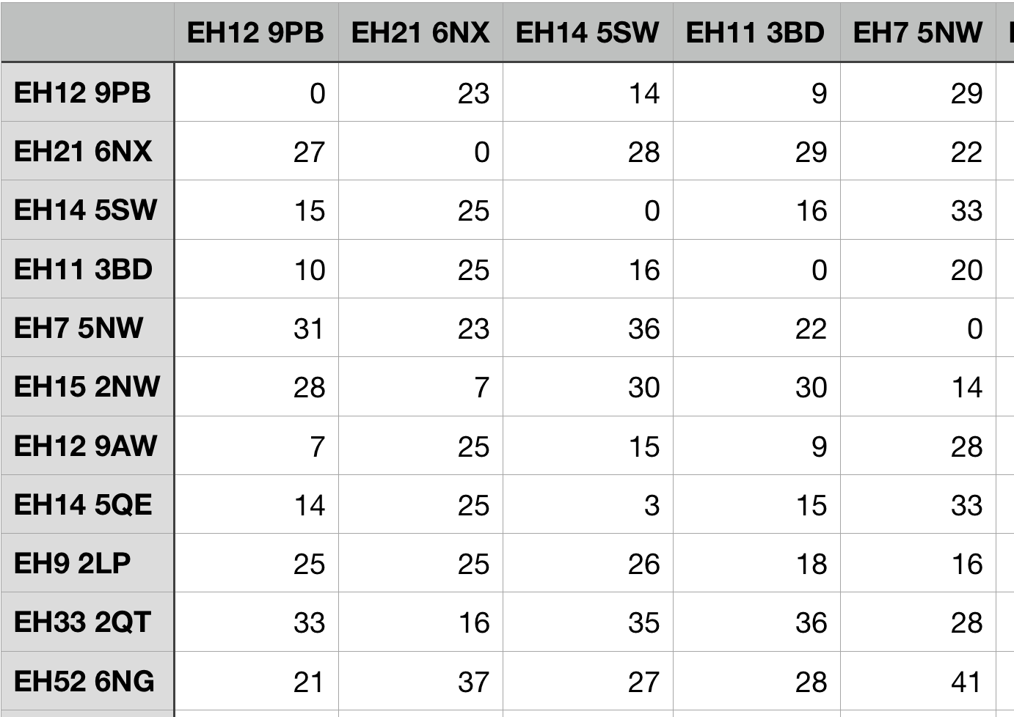
III. Data Acquisition
Delivery Service
Travel Matrix
Depot
A
B
C
D
xxxxx
A
Depot
xxxxx
B
A
xxxxx
C
B
xxxxx
D
C
xxxxx
E
D
xxxxx
F
E
xxxxx
G
F
xxxxx
H
G
xxxxx
I
H
xxxxx
J
I
J

Slide 13

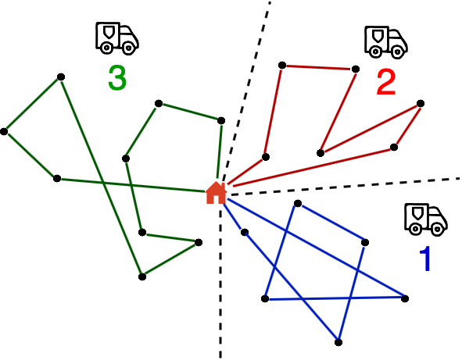
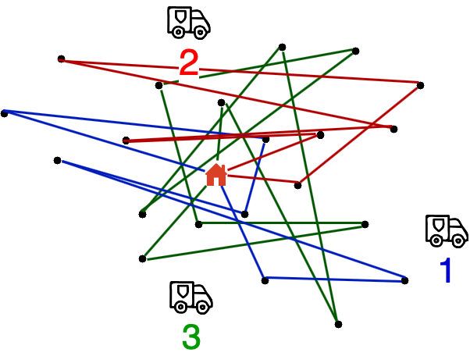
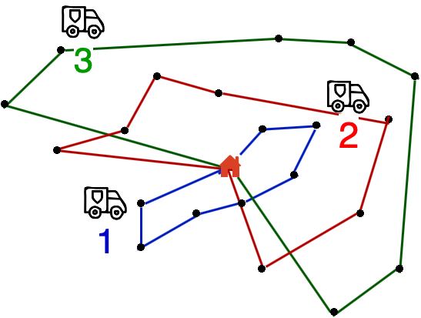
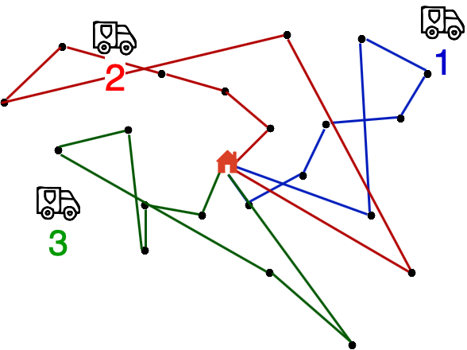
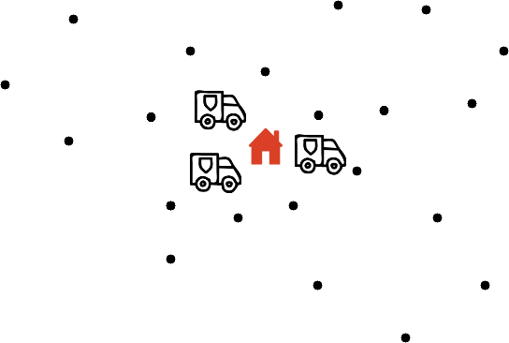
III. Initialisation
Ad-hoc Solutions
1. Random Assignment
1. Random Assignment
2. Round-Robin: assignment 1 parcel at a time…
3. Close-First: assignment 1 van at a time…
4. Alpha-Num: assignment per postcode area…
Choose Cheapest One !

Slide 14

III. Global Search … Large Neighbourhood
Destroy and Repair Operators
Destroy
1. Start from Input Solution
Input
Repair
2. Destroy a fraction of the Route: Partial route + Stash of nodes
Repair the full Route:
Re-connect nodes via a Greedy heuristic

Slide 15

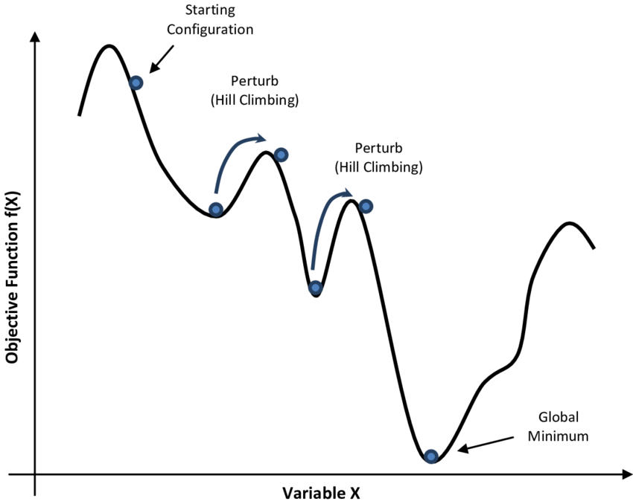
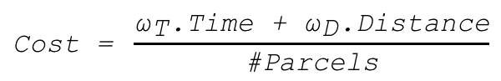
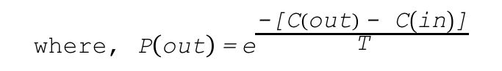
III. Simulated Annealing (SA)
Avoiding Local Optima during Convergence
apply_annealing(best, input, output):
update_temperature()
if cost(output) < cost(best):
best = output
input = output
elif P(out) > rnd(0,1):
input = output
return best, input
$$\text{Cost}\text{ = }\frac{{\text{ω}}_{\text{T}}\text{.}\text{Time}\text{ + }{\text{ω}}_{\text{D}}\text{.}\text{Distance}}{\text{\#}\text{Parcels}}$$
$$\text{where}\text{, }\text{P}\left(\text{out}\right) \text{=} {\text{e}}^{\frac{\text{−[}\text{C}\left(\text{out}\right) \text{−} \text{C}\left(\text{in}\right)\text{]}}{\text{T}}}$$

Slide 16
III. Software Architecture
Data Acquisition
Initialisation
Initial solution
Global Search (LNS)
Destroy
Repeat until Convergence
Repair
Local Search (k-opt)
Simulated Annealing
Produce Recommendation
User Interface

Slide 17

III. Deliverable
Sorting Manifest
- Hub level -
Delivery Manifest
- Van level -
Nodes | Van | Order
A | 2 | 6
B | 2 | 2
C | 1 | 2
D | 2 | 4
E | 2 | 7
F | 1 | 1
G | 2 | 4
H | 2 | 3
I | 2 | 8
J | 2 | 1
Van | #1 | #2
Drop - 1 | F | J
Drop - 2 | C | B
Drop - 3 |  | H
Drop - 4 |  | G
Drop - 5 |  | D
Drop - 6 |  | A
Drop - 7 |  | E
Drop - 8 |  | I

Slide 18
IV. Ongoing Investigations
Current Limitations
Operation Feasibility: needing input from front-line
Hard vs Soft constraints: ensuring stability of service
Future work
Engineering: reproducibility, parallelisation, scaling…
Setting-up Parameters: adaptive learning, off-line learning
Adds-on: local time-window, capacity constraints, collections…

Slide 19
IV. Questions ?
Thank You …

